Slide 1

Introduction to JSON Web Tokens (JWT)
JSON Web Tokens (JWT) are a standard method for securely transmitting information between parties as a JSON object. They are used in a wide range of applications, including authentication, authorization, and data sharing. JWTs are compact, self-contained, and can be signed and verified to ensure authenticity and integrity. This presentation will provide a comprehensive overview of JWT, exploring its structure, functionalities, and best practices for implementation.

Slide 2
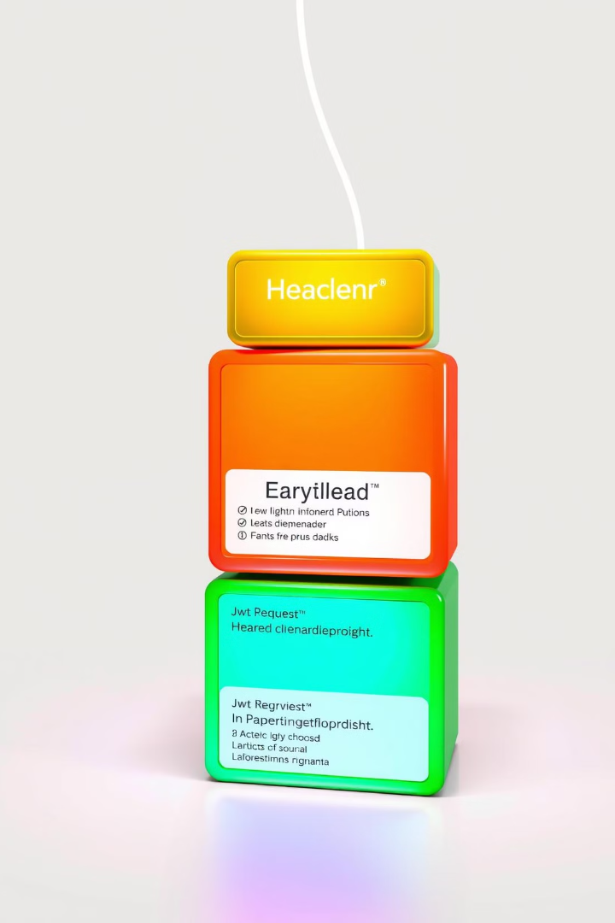
Understanding the JWT Structure
Header
Payload
The header contains information about the JWT, including the algorithm used to sign the token and the token type. This information is essential for verifying the token's authenticity. This is usually a JSON object containing two properties: 'alg' and 'typ', specifying the algorithm used to sign the token and the type of token.
The payload carries the actual data being transmitted, such as user information, permissions, or other relevant information. This data is encoded and can be accessed by the recipient of the token.
Signature
The signature is a cryptographic hash of the header and payload, encrypted using a secret key. This ensures the integrity and authenticity of the token, preventing unauthorized modifications.

Slide 3

JWT Header: Anatomy and Purpose
Property
Value
Description
alg
HS256, RS256, ES256, etc.
Algorithm used to sign the token, ensuring its integrity and authenticity.
typ
JWT
Indicates the token type, specifying it as a JSON Web Token.

Slide 4
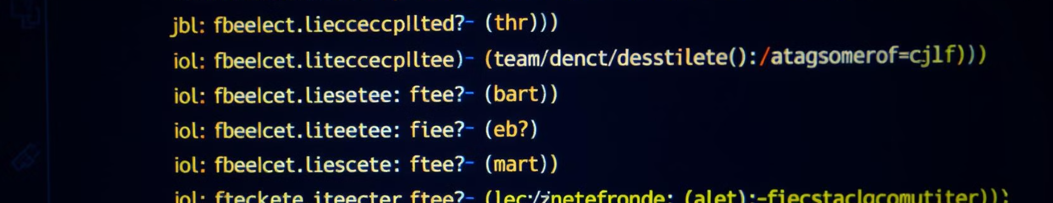
JWT Payload: Storing and Securing Data
1
User Information
2
Permissions and Roles
3
Custom Data
Stores user-specific data like name, email address, username, and other relevant attributes. This data is used for identification and authentication.
Defines the user's access rights and roles within the application, enabling authorization and access control.
Allows for storing additional information beyond user information and permissions, depending on the specific application requirements.

Slide 5




Generating a JWT Signature
Combine Header and Payload
The header and payload are concatenated into a single string, typically encoded using base64 URL encoding.
Apply Hashing Algorithm
The chosen hashing algorithm, specified in the header, is applied to the combined string, generating a unique hash value.
Encrypt with Secret Key
The generated hash value is then encrypted using a secret key known only to the parties involved in the communication. This secret key ensures the integrity of the signature.

Slide 6


Verifying a JWT Signature
1
Extract Signature
The signature is extracted from the received JWT.
2
Decrypt Signature
The signature is decrypted using the same secret key used for signing the token. This step ensures the integrity of the signature and verifies that it was generated by the intended party.
3
Validate Signature
The decrypted signature is compared with a newly generated signature based on the received header and payload. If the signatures match, the token is considered valid and authentic.

Slide 7
Structure of JWT:
Header
Contains the token type (usually JWT) and the signing algorithm (e.g., HS256 for HMAC SHA-256).
Payload:
Contains the claims, which are statements about an entity (typically, the user) and additional metadata. Claims can be:
Registered claims: Predefined claims like iss (issuer), exp (expiration time).
Public claims: Custom claims agreed upon by parties.
Private claims: Custom claims used internally.
Signature:
Created by encoding the header and payload, combining them, and then signing them with a secret key using the specified algorithm.

Slide 8
Proper JWT Request and Response Flow
Request
Response
Client sends an authentication request to the server, including user credentials.
Client sends subsequent requests to the server, including the JWT in the authorization header.
Server verifies the credentials and generates a JWT containing user information and permissions.
Server verifies the JWT, ensuring the user is authenticated and authorized.
Server sends the JWT to the client in the response header.
Server processes the request and sends a response to the client.

Slide 9

Securing JWT with HTTPS
HTTPS (Hypertext Transfer Protocol Secure) is a protocol that encrypts communication between a client and a server. This ensures that the JWT is transmitted securely, preventing eavesdropping and interception. Using HTTPS is crucial for protecting sensitive user data and ensuring the overall security of the application.

Slide 10


Handling JWT Expiration and Refresh Tokens
Expiration Time
JWTs have an expiration time, after which they are no longer valid. This ensures that tokens do not

